Slide 1
Web Services

Slide 2
What is Web Service?
Services are available in the Web.
Communication between the two system over network.
Software system designed to support interoperable machine-machine interaction over the network (w3c definition).
Real-time Example:
Facebook, Google, Twitter, e-commerce sites, and irctc.

Slide 3
Simple Use case
Application Server-1
Application Server-2
IRCTC- Ticket Service
Dealer site1 (makemytrip.com)
Struts
bookTicket()
Interface
cancelTicket()
Application Server-3
Dealer site2 (cleartrip.com)
.NET/RUBY
DB

Slide 4
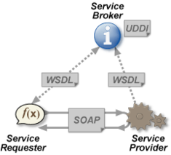
Criteria for interface and request/response
Interface should be platform independent. So what is the format? And why?
Request and response should be language natural. So what is the format? And why?

Slide 5
Web Service Terminologies
SOAP – Simple Object Access Protocol.
Envelope for soap request/response.
WSDL – Web Service Description Language.
Interface for SOAP web service
UDDI – Universal Description, Discovery and Integration.
Repository/yellow pages of web services
REST – REpresentational State Transfer.
Architecture style of communication to the services
HTTP – Hypertext Transfer Protocol.
Stateless protocol and used for transport

Slide 6
Different Types of Web Services
SOAP | REST
JAX-WS standard - (The Java API(application program interface) for XML Web Services (JAX-WS) is a Java programming language API for creating web services. JAX-WS is one of the Java XML programming APIs. It is part of the Java EE platform from Sun Microsystems.) | JAX-RS standard – (JAX-RS: Java API for RESTful Web Services (JAX-RS) is a Java programming language API that provides support in creating web services according to the Representational State Transfer (REST) architectural pattern.)
Required WSDL interface for expos as web service | No Interface. It uses HTTP methods (GET,POST,PUT,DELETE)
XML should be communication medium for request and response | Both XML and JSON used for request and response.
Maintain session state | Stateless (fire and forget)
It uses SOAP protocol to transfer data over HTTP | Uses only HTTP
Not human readable | Human readable
Client – server communication heavy weight like BLOB | Simple client-server communication and light weight.

Slide 7
SOAP vs REST
SOAP
Client
Server
Data
+
SOAP
Standard
=
Huge Data
<=>
REST
Client
Server
Data
<=>
Sending data as its
*REST are mostly used in industry

Slide 8
Web service Flow-I
Web services
HTTP
Web Browser
SOAP
WSDL
HTTP
REST
Mobile
Application Server
Not Applicable for Real time and it FALSE one for SOAP.
DB

Slide 9
Disadvantage of flow-I
Consuming SOAP services from Java Scripts is tedious and time consuming task.
Some browser will not support build in Jquery functions for SOAP.(Browser compatibility)
Security validation is needed for every service. Because anybody can access any service.
No centralized controlled.
UI change to be needed for every Web service enhancements like URL for version update.

Slide 10
Web service Flow-II (Actual)
Client for Web service
Client for Web App
Web/Servlet application
Web services
Web Browser
(Toolkit)
Java Web service Client
HTTP
SOAP
WSDL
HTTP
REST
Mobile
Web Server/application server
Application Server
DB
DB

Slide 11
Advantage of Flow-II
Centralized control.
Only authorized users/vendors can consume web services.
No UI changes needed.
Can use OAUTH/APIGEE for security.
Standard industry model

Slide 12
Examples
GeoIP service
http://www.webservicex.net/ws/WSDetails.aspx?WSID=64&CATID=12
One Time Password(OTP) service
Our own service

Slide 13
Web Service - OTP
OTP(One-Time-Password) Generator.
This web service will generate OTP for authentication for more security.
Used in banking site, e-commerce site for every transactions.
Functionality
Generate OTP and send to mail.
Validate OTP.
Get registered user.
Get all registered users.

Slide 14
Complete Application architecture (HealthCare Portal)
Servlets
Application Server (Glassfish)
SOAP Client
WSDL
Java
Generate OTP
End User
.Net
Validate
Ruby
Get Subscriber
SMTP Mail Server (GMAIL)
Get All Subscriber
Web Server
(Tomcat)
JDBC
ORM (Hibernate)
DB

Slide 15
Setup environments
Required software
JDK 1.6
IDE (Eclipse/NetBeans)
Application server (GlassFish)
Mail API
Database (postgresql DB)
Technology used
Java
XML
JDBC

Slide 16
Service Development
package com.soapwebtest.service;
import java.util.List;
import java.util.Random;
import javax.jws.WebMethod;
import javax.jws.WebService;
import com.soapwebtest.service.model.Subscriber;
@WebService
public class OTPGenerator {
@WebMethod
public boolean generateOtp(String email) {
return false;
}
public boolean validate(String mail, String otp) {
return false;
}
public Subscriber getSubscriber(String mail) {
return subscriber.
}
public List<Subscriber> getAllSubscriber() {
return List<Subscriber>
}
}

Slide 17
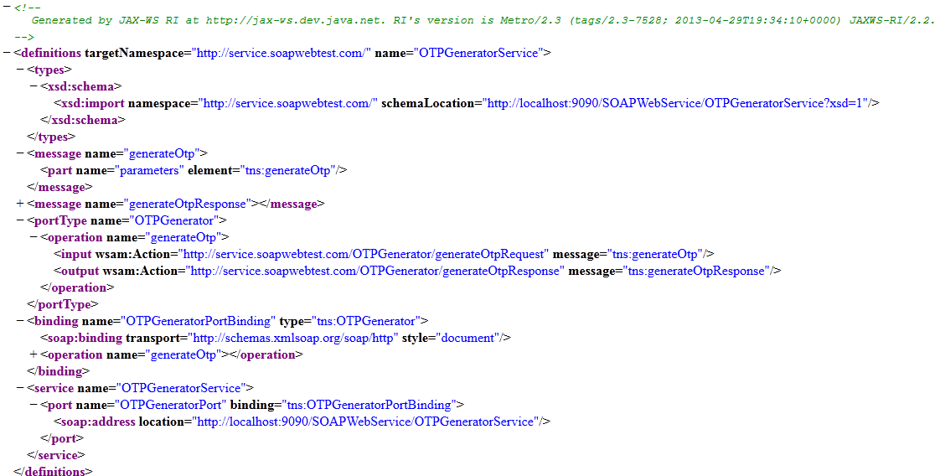
OTP service – WSDL interface

Slide 18
Compare WSDL with java Interface
package com.testapp.webservice //package name
Public interface Calculatore{ //interface name
int add(int a, int b); // method name, input and output parameters
int multiply(int a, int b);
Math add (Math math); //Object
}

Slide 19
WSDL high level elements
-<definition>
+<types> //input and output types reference
+<message> // inputs and outputs (one for input and one for output)
-<portType>
-<operation> //method name of webservice
<input> // all input and output are message
(one for input and one for output)
<output>
</operation>
+<binding> //information about how webservices accepts
its input and output via http (literal via http)
+<service> //list of ports and each port has address location.
port consist of operations
-</definition>

Slide 20
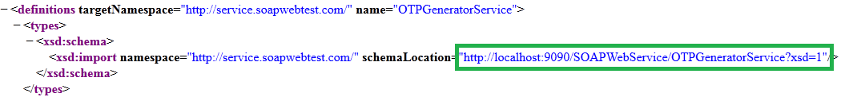
Name Space and types
Name space represent the package name of service.
Name space should be unique.
Types represents what kind of data type to passed to service input and output over HTTP.
Types will be applicable only for document style binding. Not for RPC.

Slide 21
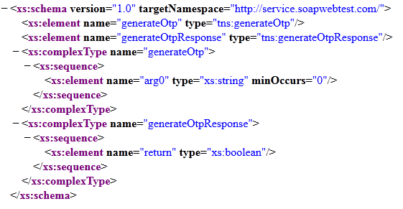
XSD Elements

Slide 22
SOAP binding style
SOAP binding represents what kind of communication and data passed to request and response for the service.
JAX-RPC | Document
no XSD | XSD document as an input and output
easy to read | complex to read
no validation | validates inputs (ex : minoccurs)
Note:
Document style binding is default

Slide 23
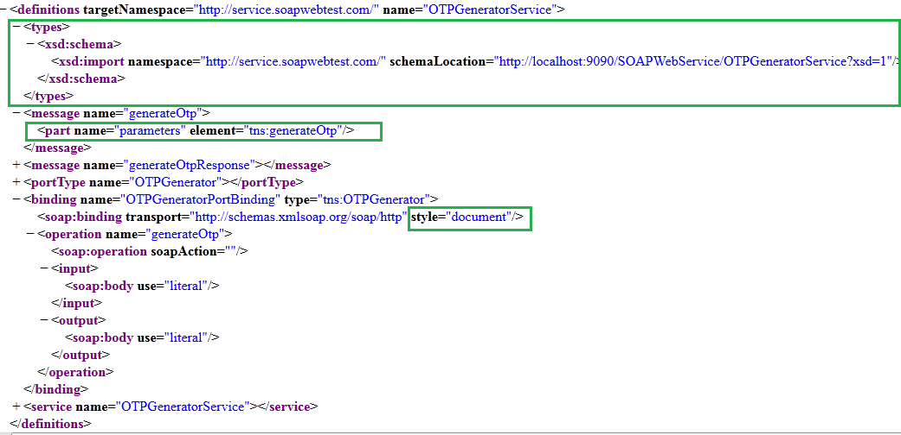
Document style binding

Slide 24
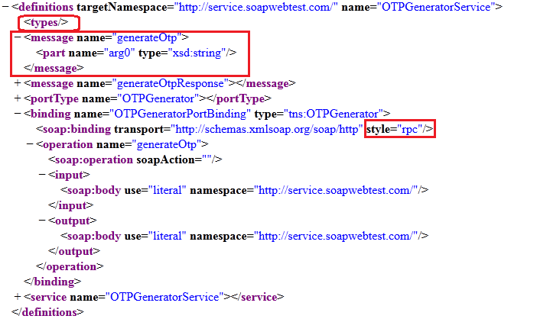
RPC binding

Slide 25
Service, portType and message
Service consist of ports and each port will have address location URL.
portType has operations of service which exposed on the particular port.
Each operation has input/output which represent as messages.

Slide 26
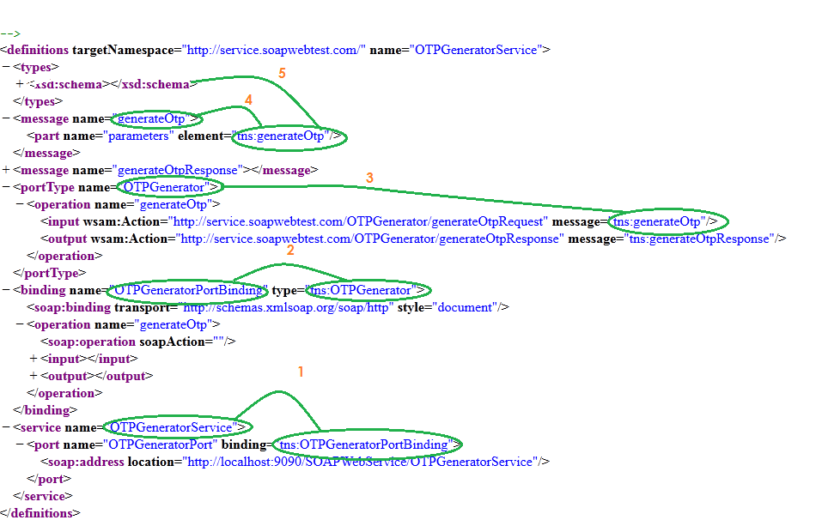
Example

Slide 27
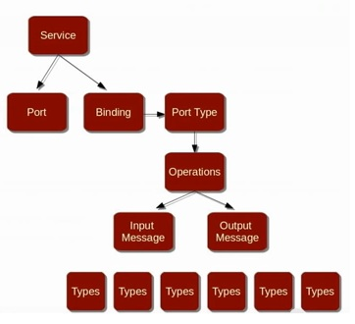
WSDL Structure

Slide 28
Web service client
One who consume web service is called web service client.
Client needs only WSDL interface.
Different Types of Clients:
Java
.Net
Ruby
Python

Slide 29
Steps to create java client
Use wsimport
Wsimport –keep –s <src> <wsdl>
Use Eclipse-IDE
Create java project.
Create Web service client.
Specify the WSDL and Validate.
Generate required classes using Axis.

Slide 30
Web Service Client Example
package com.soapwebtest.service;
import java.rmi.RemoteException;
import java.util.Arrays;
import java.util.List;
public class OTPClient {
public static void main(String[] args) throws RemoteException {
OTPGenerator service = new OTPGeneratorProxy();
List<Subscriber> ll = Arrays.asList(service.getAllSubscriber());
for (Subscriber subscriber : ll) {
System.out.println(subscriber.getEmail());
}
}
}

Slide 31
Complete Application architecture (HealthCare Portal)
Servlets
Application Server (Glassfish)
SOAP Client
WSDL
Java
Generate OTP
End User
.NET
Validate
Ruby
Get Subscriber
Mail Server (GMAIL)
Get All Subscriber
Web Server
(Tomcat)
JDBC
ORM (Hibernate)
DB

Slide 32
Developing Web Application and Integrate SOAP Client
Required Software:
Hibernate
Postgresql(Database)
Tomcat (web server)
SOAP Client
Technology
HTML
JSP
Servlets
Java
XML (web.xml)

Slide 33
Tomcat Web Server
Tomcat
Web Application
Browser
Request
Web Application
Response
Web Application
Web.xml / annotation
Login Servlet

Slide 34
Servlet Terminologies
Http- Stateless protocol
HttpRequest – scope will be only on request
HttpResponse- scope will be only on response
HttpSession – scope on particular browser/user
ServletConfig- Scope on particular servlet
ServletContext – Scope for all servlet and every browser/user.

Slide 35
Serialization
Process of storing object state for streaming called serialization.
Every java class should implements serializable interface
What is object state?
Why should we store object state?

Slide 36
Serialization
JVM
JVM
SOAP Client
Web Service
Network

